Slide 1

Used Car Price Prediction
Sai Charith Govardhanam
Yashwant Bhaidkar
Lakshmi Sravya Chalapati
Manojkumar Yerraguntla

Slide 2
SMART QUESTION: What features are affecting the price of a used car?

Slide 3
About Dataset:
This dataset contains car sale prices of used cars, it has been taken from the Kaggle website.
The dataset has 38,522 observations with 30 variables.
The data set has 30 columns:
[1-5] Manufacturer Name, Model Name, Transmission, Color, Odometer Value
[6-10] Year Produced, Engine Fuel, Engine Has Gas, Engine Type, Engine Capacity
[11-15] Body Type, Warranty, State, Drivetrain, Price in USD
[16-20] Is Exchangeable, Location, Number of Photos, Upgrade Count, Duration Listed
[21-30] Feature 0 to Feature 9

Slide 4
EXPLORATORY DATA ANALYSIS

Slide 5
Prepare for EDA:
Replaced 10 Null values with the mean in the engine capacity.
Dropped some variables like State, Duration list, engine fuel, location.
Converted transmission, engine fuel, engine type, body type, has warranty, drivetrain, and other variables into factors.
Graphs used:
Boxplot
Scatterplot
Line Graph
Probability Density Function
Tests used:
T-test
Anova Test
Chi-Square Test
Correlation Matrix

Slide 6
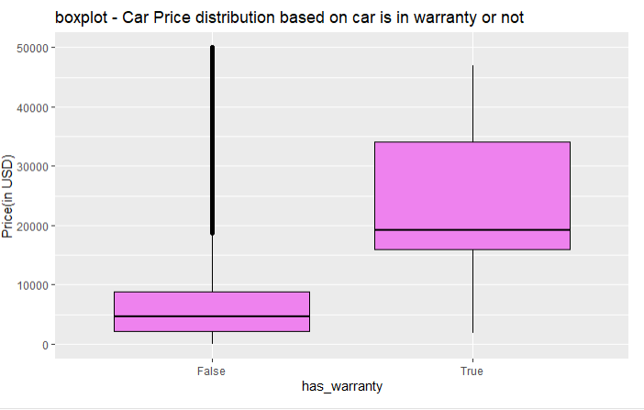
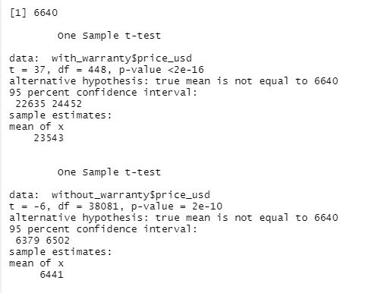
Is the warranty impacting the resale value of the cars?

Slide 7
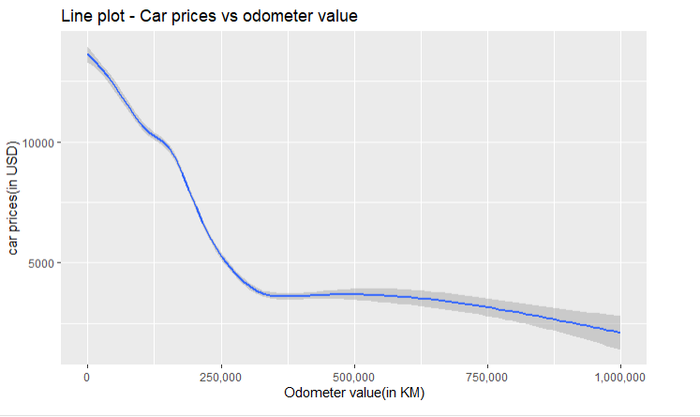
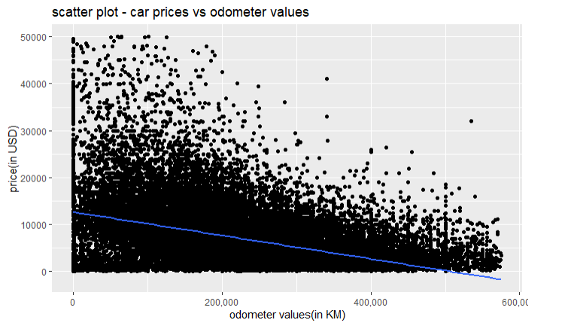
Does the odometer value have any impact on the car prices?
We observed a negative correlation of 0.42

Slide 8
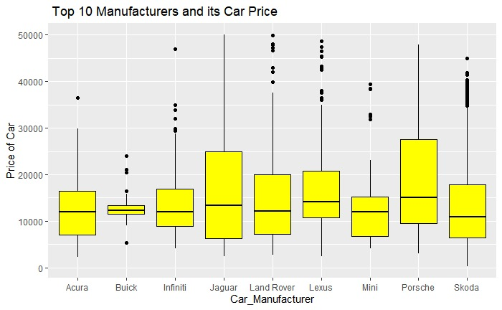
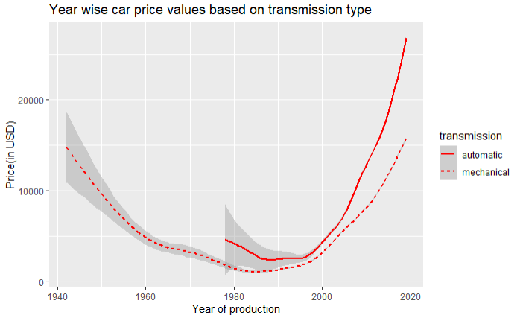
Are the car prices dependent on the manufacturer or year of production?

Slide 9
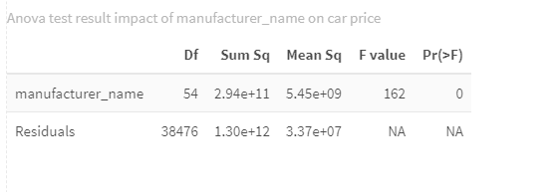
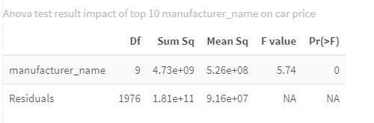

ANOVA test result on the manufacturer variable:
Is the year of production independent of car prices?

Slide 10
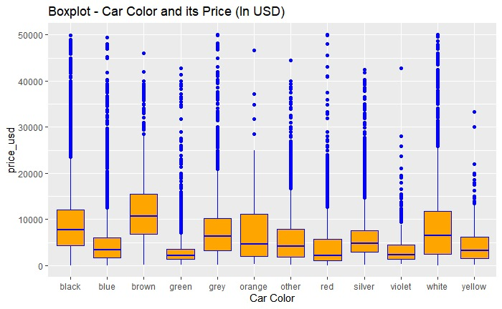
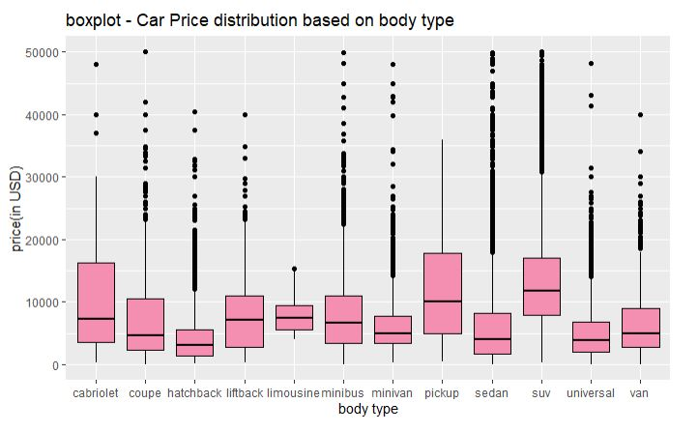
Does colour and body type have any impact on the resale prices of the cars?

Slide 11
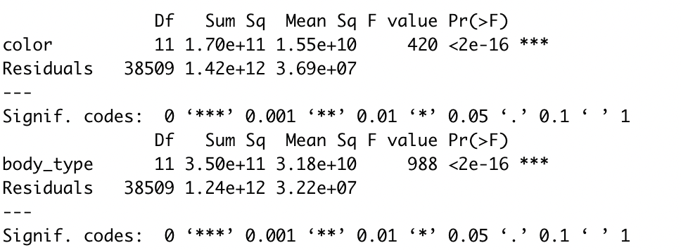
Does colour and body type have any impact on the resale prices of the cars?

Slide 12
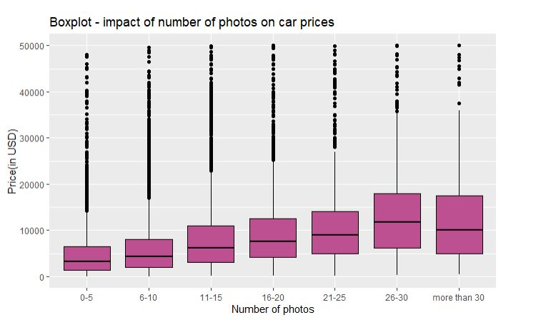
Does the number of photos have any impact on the car’s resale value?

Slide 13
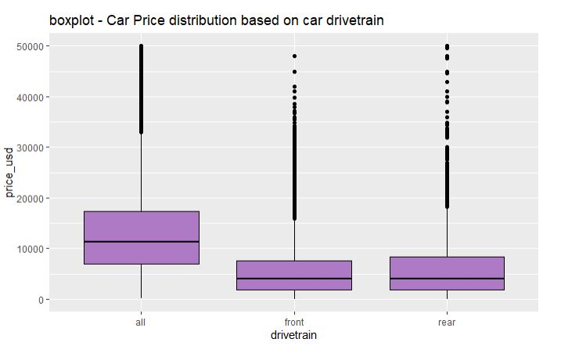
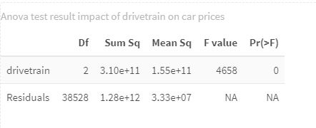
Does drivetrain have any impact on the car’s resale value?

Slide 14
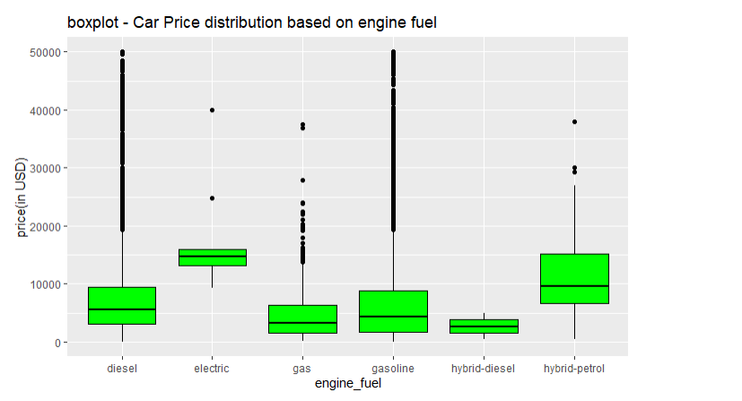
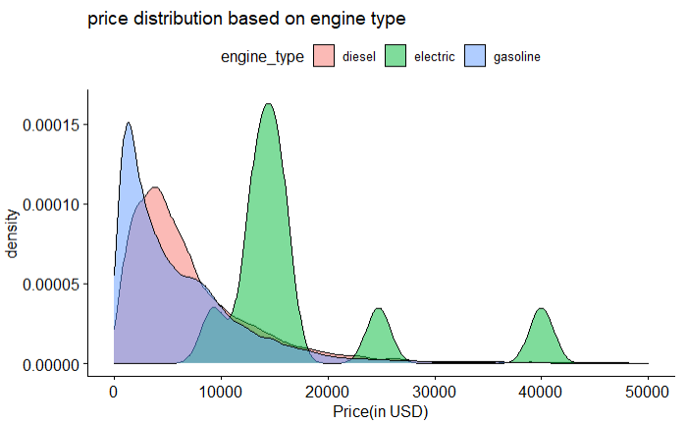
Are the resale prices of the cars dependent on fuel and engine type?

Slide 15
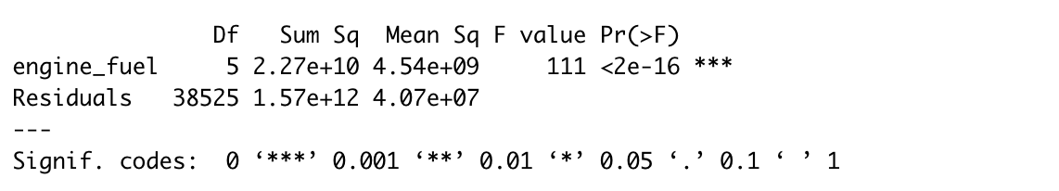
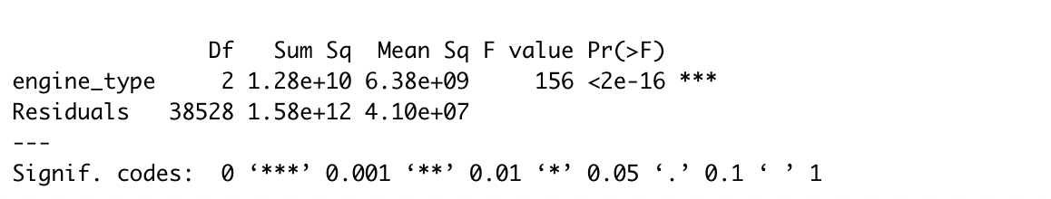
ANOVA test results for fuel and engine type variables:

Slide 16
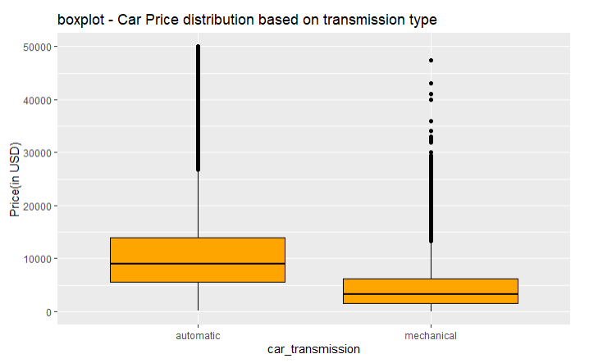
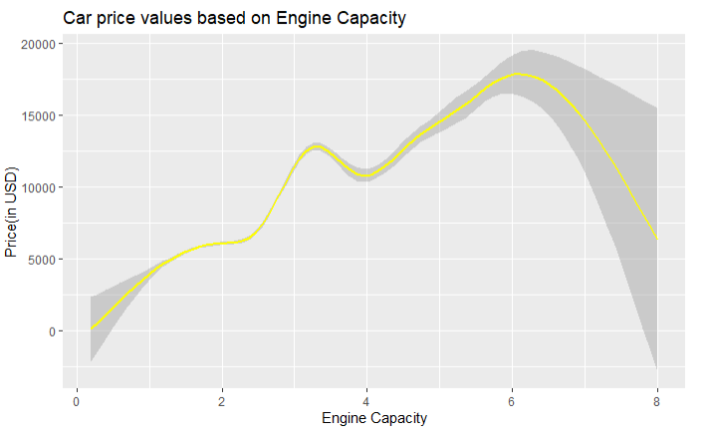
Are the prices of the cars different based on the transmission type and engine capacity?

Slide 17
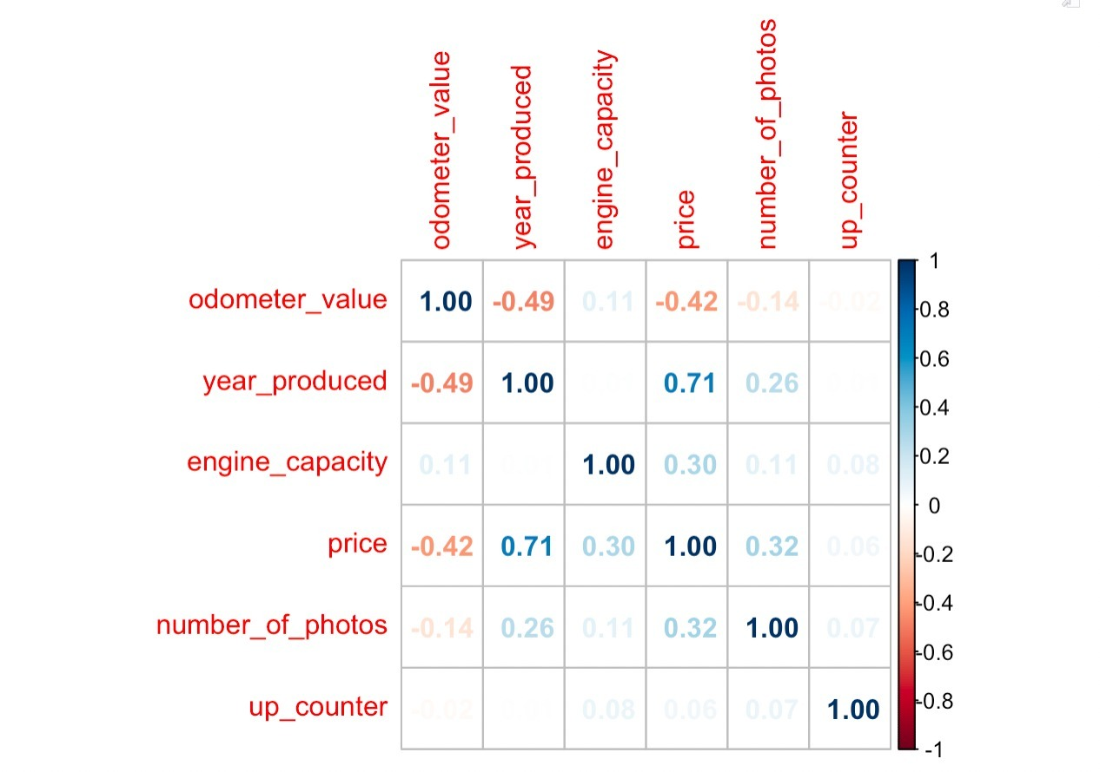
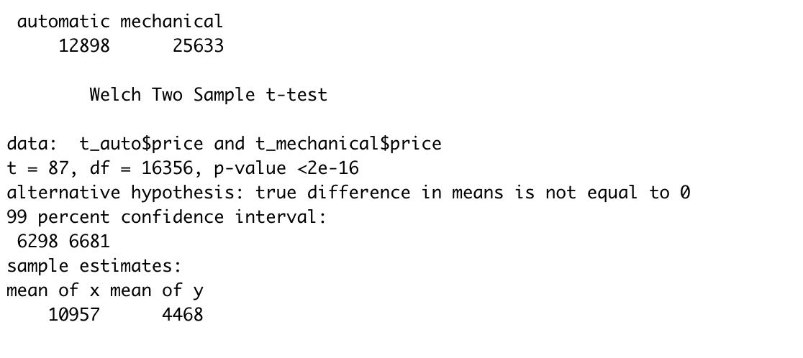
Are the prices of the cars different based on the transmission type and engine capacity?

Slide 18
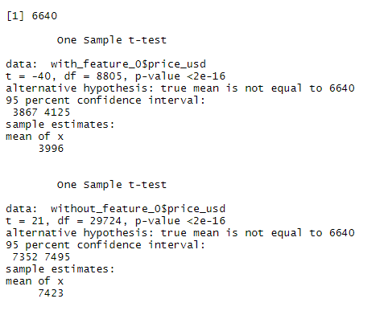
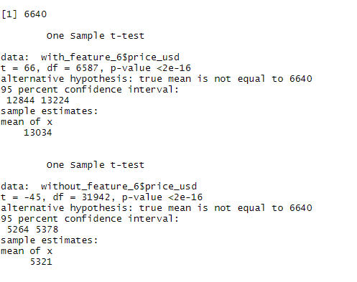
Does unknown features have any impact on car prices?

Slide 19

QUESTIONS?

Slide 20


